Slide 1
Introduction
Data Warehouse and Data Mining
(3 credits)
Dimas Aryo Anggoro

Slide 2
Course Schedule and Venues
A : Friday, 07.15 – 09.15 (J.Sem.2)
B : Friday, 09.30 – 11.30 (J.Sem.2)
X : Friday, 13.00 – 15.00 (SW706)

Slide 3
Course Components
Mid-term Exam : 30%
Final-term Exam : 40%
Others : 30%
  Assignments
  Quizzes
  Class contributions

Slide 4
You will be studying
1. Introduction
2. Data Preprocessing
3. Naive Bayes
4. Decision Trees
5. Neural Networks
6. Association Rules
7. Mid-exam Review
8. K-Nearest Neighbors
9. K-means Clustering
10. Linear Regressions
11. Support Vector Machines
12. ETL, OLTP, and OLAP
13. Data Warehouse Design
14. Final-exam Review

Slide 5
Keep in mind that
This course is focusing on the theory, algorithms, mathematical and statistical concepts.
If you are interested in more detail in Data Science, you need to learn the concepts, not the tools.
The programming languages that are in demand include Python, R, and MATLAB.
However, you will be using a tool (WEKA or RapidMiner) for the laboratory works.

Slide 6
Before we start...
What is your motivation to attend this class?
What is your motivation to choose Information Systems and Enterprise?
Are you sure that this major suitable for you?
Are you sure that this course will be beneficial for your future job?
What do you expect after graduating from this major?

Slide 7
Course Outline
Data Mining
Machine Learning
Case Studies
Weka (Laboratory works)

Slide 8
Lesson Outline
Introduction: Data Flood
Data Mining Application Examples
Data Mining & Knowledge Discovery
Data Mining Tasks

Slide 9
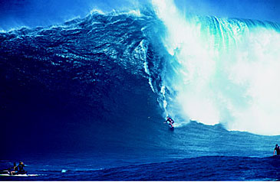
Trends leading to Data Flood
More data is generated:
  Bank, telecom, other business transactions ...
  Scientific data: astronomy, biology, etc
  Web, text, and e-commerce

Slide 10
Big Data Examples
Europe's Very Long Baseline Interferometry (VLBI) has 16 telescopes, each of which produces 1 Gigabit/second of astronomical data over a 25-day observation session
  storage and analysis a big problem
AT&T handles billions of calls per day
  so much data, it cannot be all stored -- analysis has to be done “on the fly”, on streaming data

Slide 11
Largest databases in 2003
Commercial databases:
  Winter Corp. 2003 Survey: France Telecom has largest decision-support DB, ~30TB; AT&T ~ 26 TB
Web
  Alexa internet archive: 7 years of data, 500 TB
  Google searches 4+ Billion pages, many hundreds TB
  IBM WebFountain, 160 TB (2003)
  Internet Archive (www.archive.org),~ 300 TB

Slide 12
From terabytes to exabytes to …
UC Berkeley 2003 estimate: 5 exabytes (5 million terabytes) of new data was created in 2002.
www.sims.berkeley.edu/research/projects/how-much-info-2003/
US produces ~40% of new stored data worldwide
2006 estimate: 161 exabytes (IDC study)
  www.usatoday.com/tech/news/2007-03-05-data_N.htm
2010 projection: 988 exabytes

Slide 13
Largest Databases in 2005
Winter Corp. 2005 Commercial Database Survey:
  Max Planck Inst. for Meteorology , 222 TB
  Yahoo ~ 100 TB (Largest Data Warehouse)
  AT&T ~ 94 TB

Slide 14
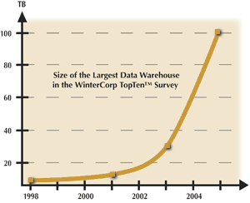
Data Growth
In 2 years, the size of the largest database TRIPLED!

Slide 15
Data Growth Rate
Twice as much information was created in 2002 as in 1999 (~30% growth rate)
Other growth rate estimates even higher
Very little data will ever be looked at by a human
Knowledge Discovery is NEEDED to make sense and use of data.

Slide 16
Machine Learning / Data Mining
Application areas
Science
  astronomy, bioinformatics, drug discovery, …
Business
  CRM (Customer Relationship management), fraud detection, e-commerce, manufacturing, sports/entertainment, telecom, targeted marketing, health care, …
Web:
  search engines, advertising, web and text mining, …
Government
  surveillance, crime detection, profiling tax cheaters, …

Slide 17
Data Mining for Customer Modeling
Customer Tasks:
  targeted marketing:
    cross-sell, customer acquisition
  credit-risk
  fraud detection
Industries
  banking, telecom, retail sales, …

Slide 18
Assessing Credit Risk: Case Study
Situation: Person applies for a loan
Task: Should a bank approve the loan?
Note: People who have the best credit don’t need the loans, and people with worst credit are not likely to repay. Bank’s best customers are in the middle

Slide 19
Credit Risk - Results
Banks develop credit models using variety of machine learning methods.
Mortgage and credit card proliferation are the results of being able to successfully predict if a person is likely to default on a loan
Widely deployed in many countries

Slide 20
e-commerce
A person buys a book (product) at Amazon.com
What is the task?

Slide 21
Successful e-commerce – Case Study
Task: Recommend other books (products) this person is likely to buy
Amazon does clustering based on books bought:
  customers who bought “Advances in Knowledge Discovery and Data Mining”, also bought “Data Mining: Practical Machine Learning Tools and Techniques with Java Implementations”
Recommendation program is quite successful

Slide 22
Security and Fraud Detection - Case Study
Credit Card Fraud Detection
Detection of Money laundering
  FAIS (US Treasury)
Securities Fraud
  NASDAQ KDD system
Phone fraud
  AT&T, Bell Atlantic, British Telecom/MCI
Bio-terrorism detection at Salt Lake Olympics 2002

Slide 23
Data Mining and Privacy
in 2006, NSA (National Security Agency) was reported to be mining years of call info, to identify terrorism networks
Social network analysis has a potential to find networks
Invasion of privacy – do you mind if your call information is in a gov database?
What if NSA program finds one real suspect for 1,000 false leads ? 1,000,000 false leads?

Slide 24
Problems Suitable for Data-Mining
require knowledge-based decisions
have a changing environment
have sub-optimal current methods
have accessible, sufficient, and relevant data
provides high payoff for the right decisions!
Privacy considerations important if personal data is involved

Slide 25
Related Fields
Machine
Learning
Visualization
Data Mining and
Knowledge Discovery
Statistics
Databases

Slide 26
Statistics, Machine Learning and
Data Mining
Statistics:
  more theory-based
  more focused on testing hypotheses
Machine learning
  more heuristic
  focused on improving performance of a learning agent
  also looks at real-time learning and robotics – areas not part of data mining
Data Mining and Knowledge Discovery
  integrates theory and heuristics
  focus on the entire process of knowledge discovery, including data cleaning, learning, and integration and visualization of results

Slide 27
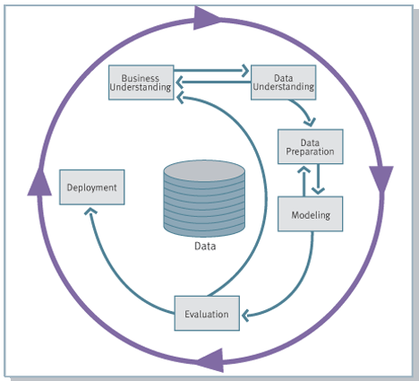
Knowledge Discovery Process flow, according to CRISP-DM
see
www.crisp-dm.org
for more
information
Monitoring

Slide 28
Historical Note:
Many Names of Data Mining
Data Fishing, Data Dredging: 1960-
  used by Statistician (as bad name)
Data Mining :1990 --
  used DB, business
Knowledge Discovery in Databases (1989-)
  used by AI, Machine Learning Community
also Data Archaeology, Information Harvesting, Information Discovery, Knowledge Extraction, ...
Currently: Data Mining and Knowledge Discovery
are used interchangeably

Slide 29
Data Mining Tasks: Classification
Learn a method for predicting the instance class from pre-labeled (classified) instances
Many approaches: Statistics,
Decision Trees, Neural Networks,
...

Slide 30
Data Mining Tasks: Clustering
Find “natural” grouping of instances given un-labeled data

Slide 31
Summary:
Technology trends lead to data flood
  data mining is needed to make sense of data
Data Mining has many applications, successful and not
Knowledge Discovery Process
Data Mining Tasks
  classification, clustering, …

Slide 32
You’re given this data
Age
Spectacle
Astigmatism
Tear production rate
Lenses
21
Myope
No
Reduced
None
15
Myope
No
Normal
Soft
17
Myope
Yes
Reduced
None
25
Myope
Yes
Normal
Hard
30
Hypermetrope
No
Reduced
None
28
Hypermetrope
No
Normal
Soft
19
Hypermetrope
Yes
Reduced
None
26
Hypermetrope
Yes
Normal
Hard
45
Myope
No
Reduced
None
36
Myope
No
Normal
Soft
46
Myope
Yes
Reduced
None
42
Myope
Yes
Normal
Hard
38
Hypermetrope
No
Reduced
None
38
Hypermetrope
No
Normal
Soft
35
Hypermetrope
Yes
Reduced
None
39
Hypermetrope
Yes
Normal
None
63
Myope
No
Reduced
None
71
Myope
No
Normal
None
67
Myope
Yes
Reduced
None
55
Myope
Yes
Normal
Hard
52
Hypermetrope
No
Reduced
None
63
Hypermetrope
No
Normal
Soft
75
Hypermetrope
Yes
Reduced
None
63
Hypermetrope
Yes
Normal
None

Slide 33
Simple Data Mining Questions
n = ...
n(Age = 63) = ...
n(Astigmatism = No) = ...
n(Lenses = soft AND Astigmatism = Yes) = ...
n(Spectacle = Myope, Age > 50) = ...
n(Age > 30 OR Lenses = None) = ...

Slide 34
Simple Data Mining Questions
P(Age < 20) = ...
P(Astigmatism = No) = ...
P(Lenses = Soft) AND P(Astigmatism = Yes) = ...
P(Spectacle = Myope, Age > 50) = ...
P(Age < 50) U P(Lenses = Hard) = ...

Slide 35
Simple Data Mining Questions
Shape of the data?
Dimensions of the data?
The difference between Vectors vs Matrices?
Find the maximum and minimum value of the age!
Find the mean, median, mode of the age!
Find the standard deviation and variance of the age!

